Slide 1
GEEKSOFGURUKUL
PROJECT NAME
RETAIL ANALYSIS (SQL PROJECT)
PRESENTED BY ANSHITA CHACHUDIYA

Slide 2
DESCRIPTION
This project E-Commerce app that is continuously working on optimizing the app. This project involves analysing the orders to analyse daily trends and conversion rate and analyse user base growth . The goal is to understand the app performance .To generate the required and compile comprehensive report using SQL . The analysis is conducted using SQL to aggregate and join data from different tables representing each e-commerce date .

Slide 3
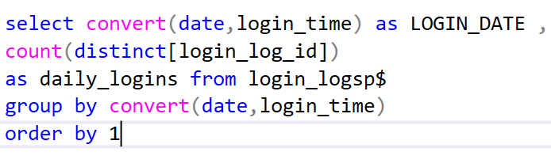
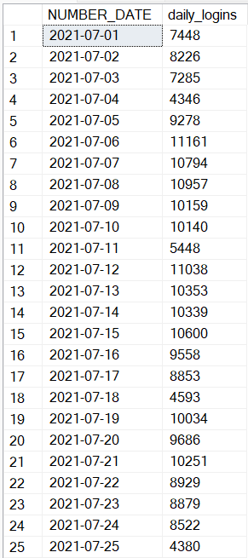
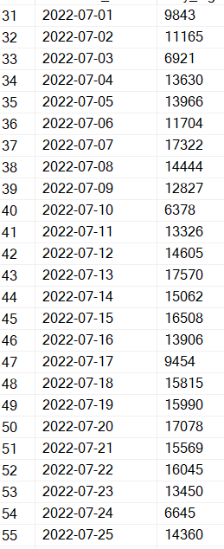
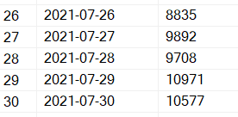
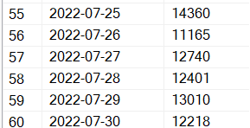
THE NUMBER OF LOGINS ON A DAILY BASIC

Slide 4
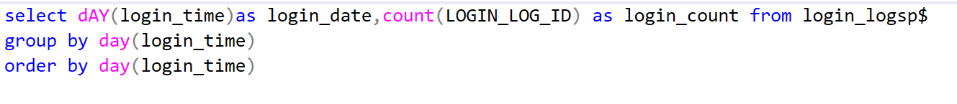
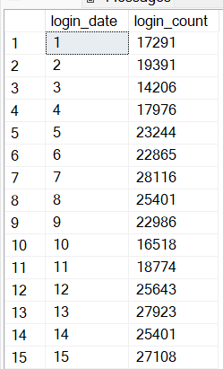
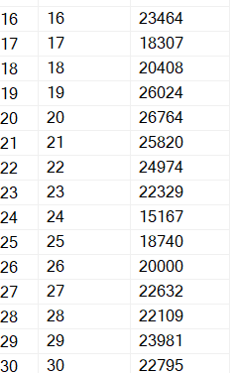
ANALYZE Daily trends of login

Slide 5
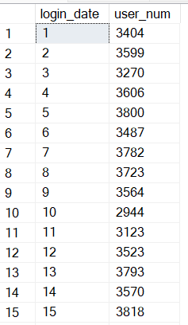
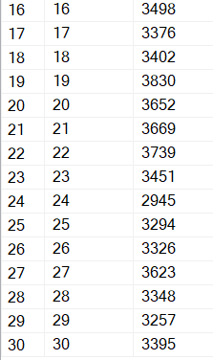
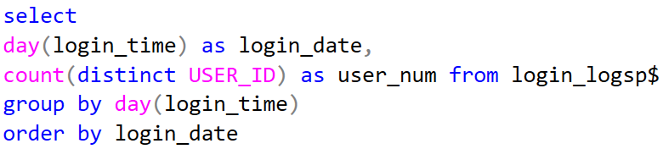
KPI to measure the performance of the app
Daily active user (DAU)

Slide 6
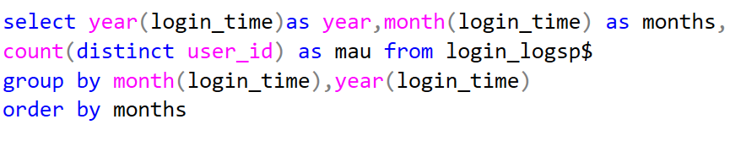
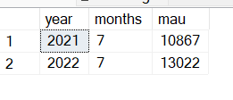
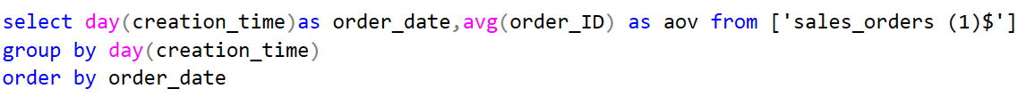
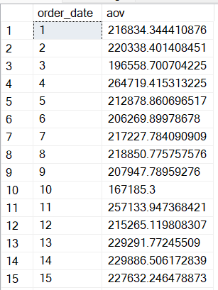
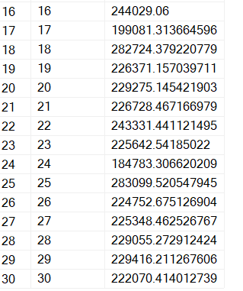
2. MONTHLY ACTIVE USER 3. AVERAGE ORDER VALUE

Slide 7
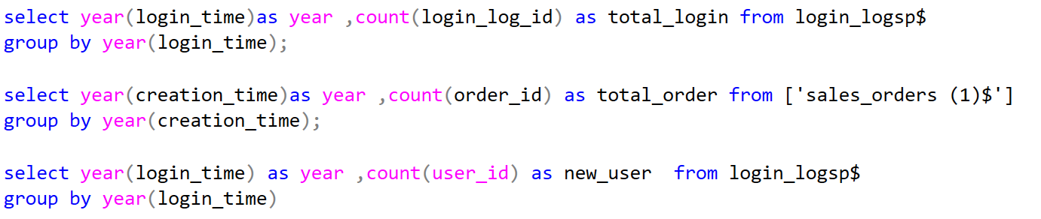

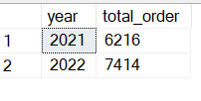
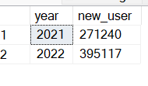
REPORT REGARDING OUR GROWTH BETWEEN THE 2 YEAR
YEARLY GROWTH IN LOGINS , ORDERS AND USER BASE GROWTH

Slide 8
Did our business grow ?
Yes , our business grew.
Does our app performance better now ?
Yes , our app performances better now .
Did our user base grow ?
Yes , our user based grow.

Slide 9
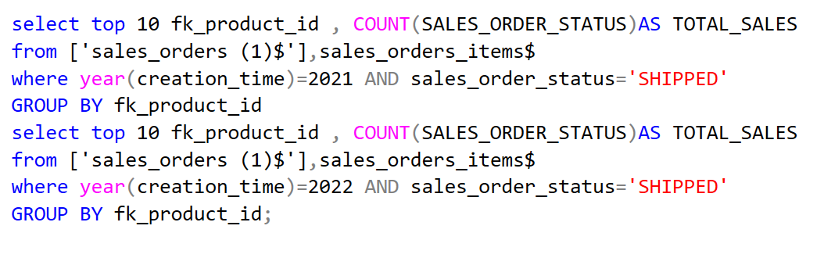
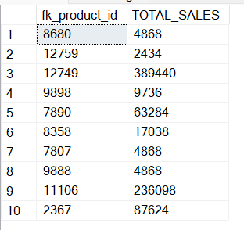
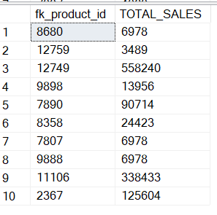
TOP – SELLING PRODUCTS IN EACH TEAR

Slide 10
TOP SELLING PRODUCT ID IN 2021
TOP SELLING PRODUCT ID IN 2022

Slide 11
CONCLUSION
This analysis provide a detailed and insightful report that captures the necessary information and provide actionable insight for the e-commerce app optimization . We ware able to effectively aggregate and compare the data . The finding a top selling product id in each year and KPI(key performance indicator ) , performance of the e-commerce app .

Slide 12
THANK YOU

